Slide 1
FTC Programmers’
Crash Course

Slide 2
FTC Programmers’ Crash Course
Agenda
Our Options (and our choices) (5 mins)
Control Hub + Expansion Hub (15 mins)
Gamepads (10 mins)
Setting Up Your Code Environment (Task)
Starter Kit Code Explanation (30 mins)

Slide 3
Our Options (and our choices)
5 mins

Slide 4
Our Options (and our choices)
OnBot Java
Notes:
OnBot Java uses a similar method of using a browser to code and save directly to the phone. The difference being that a programming language called Java is used instead.
Advantages
- Recommended if you’re learning or have learned some programming, even better if you know a little Java.
- Greater flexibility than Blocks
- There are a lot more resources available in case you need help
- More applicable to the real-world than Blocks
- Maintains most of the advantages of Blocks
Disadvantages
- No other wifi when wireless uploading
- Using external libraries is difficult and borderline impossible
- Steeper learning curve than Blocks

Slide 5
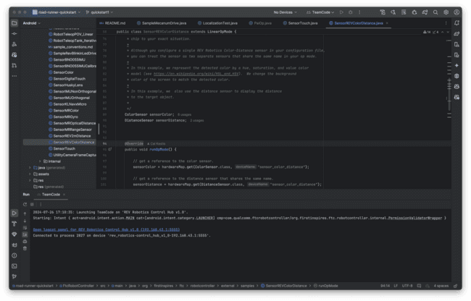
Our Options (and our choices)
Android Studio
OnBot Java
Notes:
Android Studio is a comprehensive Integrated Development Environment (IDE) that uses Java to program the phones. Instead of using a browser to upload code, Android Studio will compile your Robot Controller code into a .apk file (an app installer), and install that on the phone.
Advantages
- Recommended if you’re learning or have learned some programming, even better if you know a little Java.
- Much greater flexibility than Blocks.
- Much easier to integrate libraries like EasyOpenCV, FTC Dashboard, FTCLib, and Road Runner.
- Can use plugins like Road Runner.
- Can use either a USB connection to the RC phone, or a wireless connection to upload code.
- Can debug in real-time
- Many resources for Java, Android Studio, and IDEA
Disadvantages
- No other wifi network while code upload
- Relatively easy setup process, but time consuming and is a hefty install (3GB of files between Android Studio, ftc_app, and other libraries)
- Issues can be difficult to diagnose and solve

Slide 6
Our Options (and our choices)
Blocks
OnBot Java
Android Studio
Notes:
Blocks
The Blocks Programming Tool is a simple way to code simple actions for the robot. It has a colorful and lego-like design and includes sounds of block pieces of snapping together.
Advantages
Good for beginners: one of the easiest and simplest options to use.
Easy to set up: requires a device (laptop, chromebook, tablet) and a phone in the Program & Manage screen
Programs can be saved directly to the phone
Changes can be made quickly
Doesn’t require an external Wi-Fi connection
Disadvantages
Not recommended if you’re already familiar with some type of programming
Primarily a teaching tool for people with no programming experience
This will change your primary Wi-Fi network to the Robot Controller’s Direct Wi-Fi network, and as such, you will be unable to access the internet while connected to this particular network.
Sacrifices flexibility and application for simplicity

Slide 7
Our Options (and our choices)
OnBot Java
Blocks
Android Studio
Notes:
Blocks is too basic, not great enough, onbot java constrains to only ftc libraries. Additionally, both onbot and blocks restricts to being in the same room as the bot. So android studio best + industry experience

Slide 8
Control Hub + Expansion Hub
15 mins

Slide 9
Control Hub + Expansion Hub
Introduction
The control hub is the brain of your FTC robot. It has many inbuilt components, emulating an Android device. It also has an inbuilt IMU.
Since the Control Hub has a limited number of ports, we can use the Expansion Hub to augment the Control Hub’s functionality.
HOWEVER-
The Expansion Hub doesn’t have any built in processing power inside it, think of it like a USB hub, it simply provides more ports to the Control Hub.

Slide 10
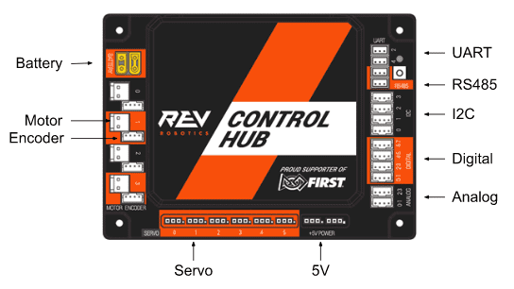
Notes:
Inter-Integrated Circuit- I2C
Universal Asynchronous Receiver/Transmitter- UART

Slide 11
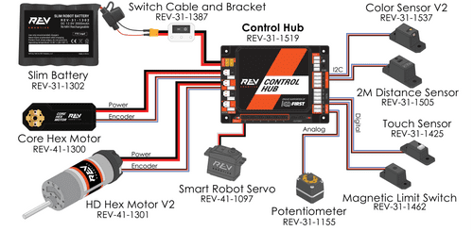

Slide 12
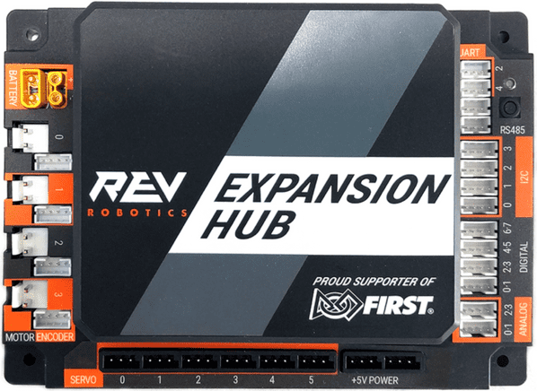

Slide 13
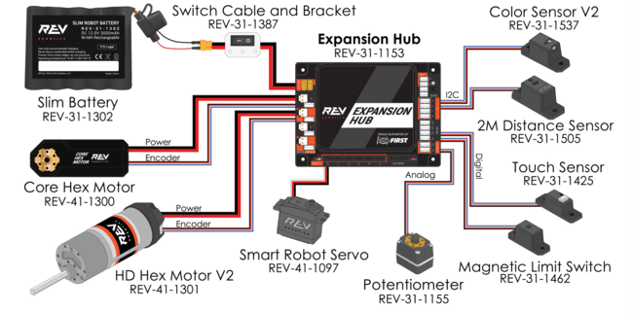

Slide 14
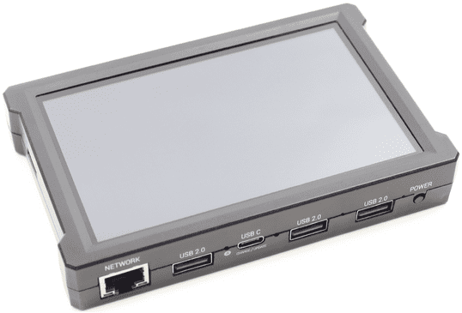

Slide 15
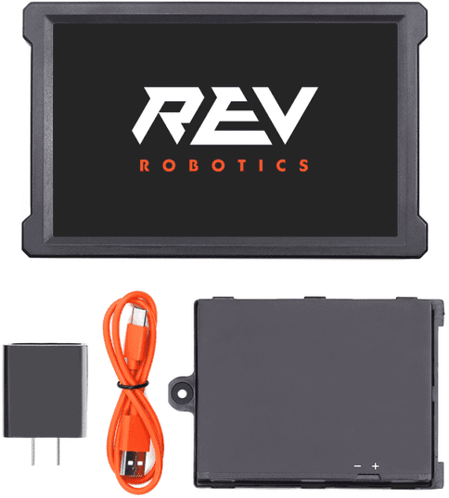
Notes:
REV Driver Hub
The REV Robotics Driver Hub is effectively an Android phone with built in USB ports. It is purpose built for FTC®, and has several advantages over traditional Android phones.
Advantages
- Full sized USB ports do not require flimsy On The Go (micro-USB connector to USB-A port) cables
- Charges from USB-C including fast charging Power Delivery modes
- Larger screen than many Android phones
- Case is more robust then a standard Android phone
Disadvantages
- Price: A Driver Hub costs $250.00, whereas legal Android phones can be purchased secondhand for less
- Power Issues: Teams have reported random losses of power coming from an improperly sized battery.
- Battery Issues: Teams have reported high battery drain in sleep mode, leading to hubs dying faster then expected
- Wifi Issues: The wifi driver will occasionally crash when the device goes to sleep, requiring a device restart

Slide 16
Sensor Glossary
CV
Webcam (Logitech C270)
Pos. Tracking
Rev Throughbore Encoders
Color/Distance Sensing
Rev Color Distance Sensor V3
Misc.
IMU
Beam Breaker
Touch Sensor
Notes:
Color and distance sensor can be used differently

Slide 17
Gamepads
10 mins

Slide 18
Gamepads
FTC has a short list of legal gamepads. As of the CENTERSTAGE season, these included-
Logitech F310
Xbox 360 Controller
DualShock 4 Controller (Wired)
DualSense Controller (Wired)
DualSense Edge controllers are disallowed

Slide 19
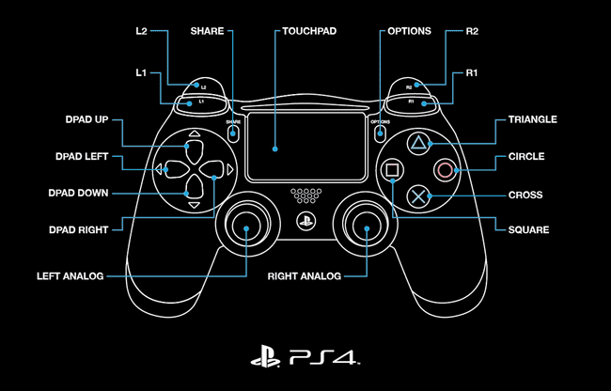

Slide 20
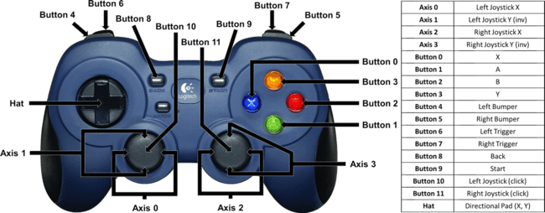

Slide 21
PlayStation | Xbox
Circle | B
Cross | A
Triangle | Y
Square | X
Share | Back
Options | Start
PS | Guide

Slide 22
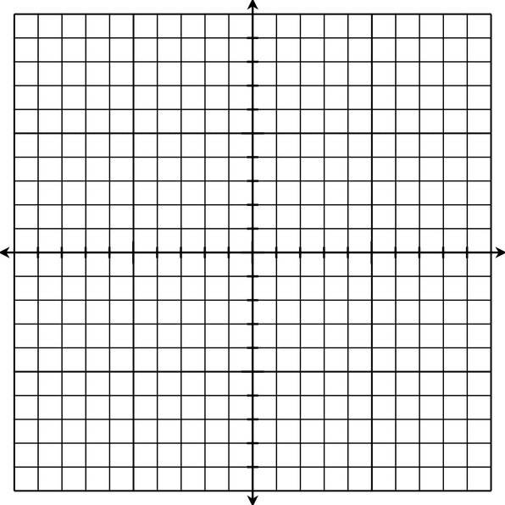

Slide 23
Setting Up Your
Code Environment

Slide 24
Setting Up Your Code Environment
Tools We’ll Use
Android Studio with JDK
ADB
Rev Hardware Client (Windows only)
RoadRunner Quickstart Setup

Slide 25
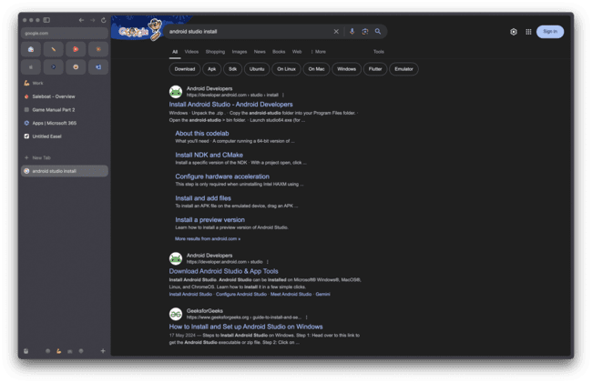

Slide 26
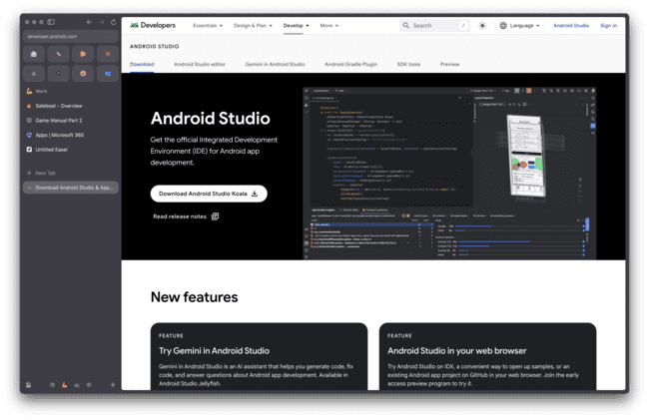

Slide 27
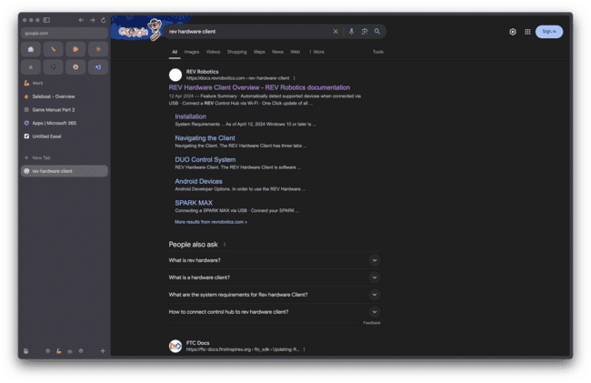

Slide 28
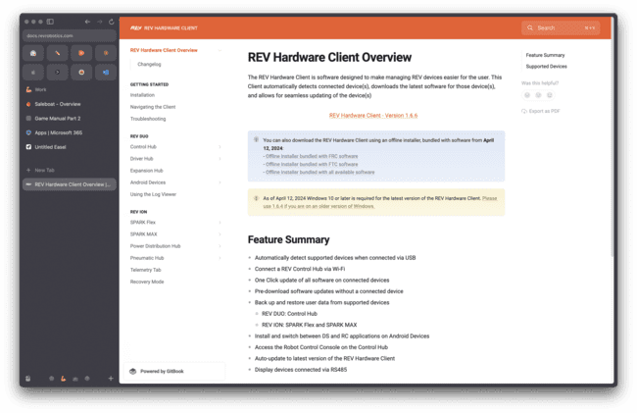

Slide 29
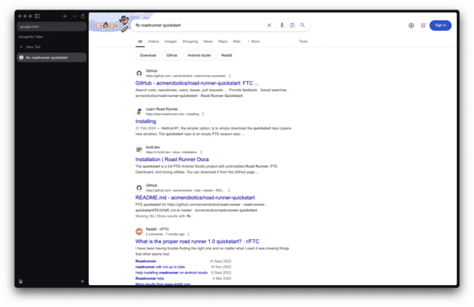

Slide 30
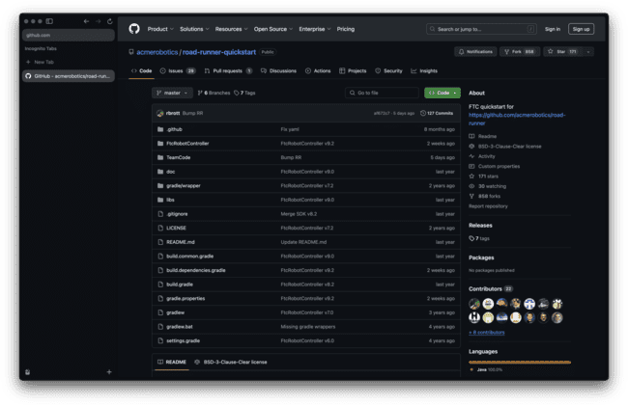

Slide 31
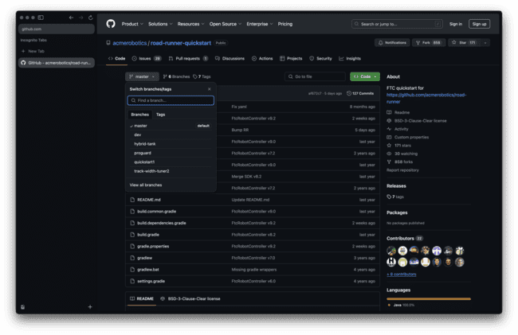

Slide 32
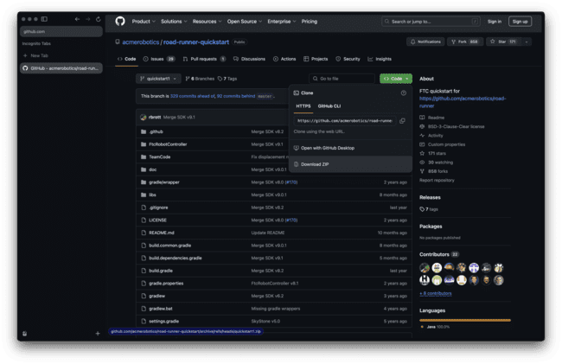

Slide 33
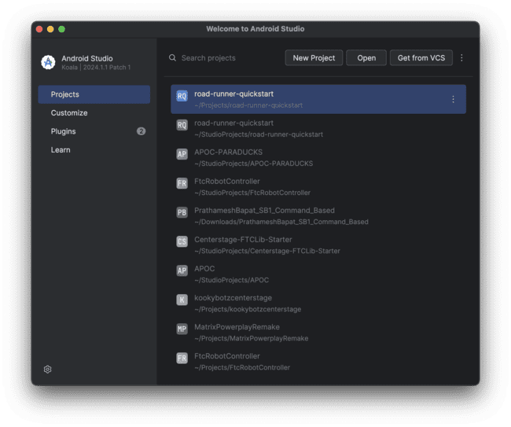

Slide 34
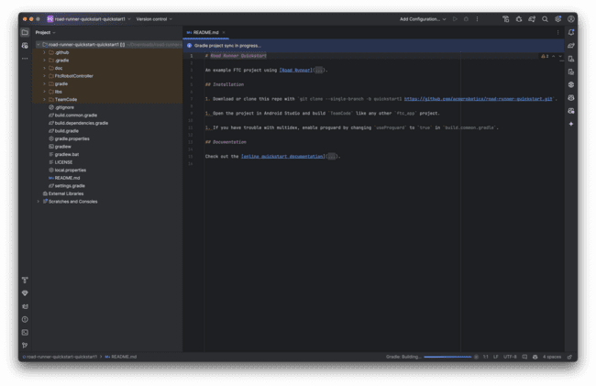

Slide 35


Slide 36
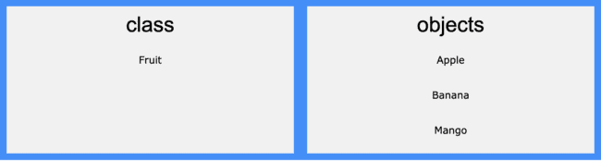
Notes:
A class is a template for objects, and an object is an instance of a class.
When the individual objects are created, they inherit all the variables and methods from the class.

Slide 37
class Vehicle {
protected String brand = "Ford"; // Vehicle attribute
public void honk() { // Vehicle method
System.out.println("Tuut, tuut!");
}
}
class Car extends Vehicle {
private String modelName = "Mustang"; // Car attribute
public static void main(String[] args) {
// Create a myCar object
Car myCar = new Car();
// Call the honk() method (from the Vehicle class) on the myCar object
myCar.honk();
// Display the value of the brand attribute (from the Vehicle class) and the value of the modelName from the Car class
System.out.println(myCar.brand + " " + myCar.modelName);
}
}
Notes:
In Java, it is possible to inherit attributes and methods from one class to another. We group the "inheritance concept" into two categories:
subclass (child) - the class that inherits from another class
superclass (parent) - the class being inherited from
To inherit from a class, use the extends keyword.

Slide 38
class Adder{
static int add(int a,int b) {return a+b;}
static int add(int a,int b,int c) {return a+b+c;}
}
class TestOverloading1{
public static void main(String[] args){
System.out.println(Adder.add(11,11));
System.out.println(Adder.add(11,11,11));
}}
Notes:
In this example, we have created two methods, first add() method performs addition of two numbers and second add method performs addition of three numbers.
Same function, different forms

Slide 39
public class Main
Public | Methods and Properties accessible by any class
Private | Methods and Properties accessible by only this class
Notes:
In this example, we have created two methods, first add() method performs addition of two numbers and second add method performs addition of three numbers.
Same function, different forms

Slide 40
Starter Kit Code Explanation

Slide 41
@TeleOp(group = "Pai")
public class PaiOp extends LinearOpMode {
private DcMotorEx leftMotor, rightMotor;
private Servo noseGear;
// Center position of the servo
double centerPosition = 0.5;
// Maximum rotation from center (90 degrees each way)
double maxRotation = 0.25;
// Current position, starting at center
double currentPosition = centerPosition;
void Initialize()
{
leftMotor = hardwareMap.get(DcMotorEx.class, "leftMotor");
rightMotor = hardwareMap.get(DcMotorEx.class, "rightMotor");
noseGear = hardwareMap.get(Servo.class, "noseGear");
noseGear.setPosition(0.5);
}
@Override
public void runOpMode() {
// Call our custom Initialize function declared before
Initialize();
// Wait for the start button to be pressed
waitForStart();
// Run until the end of the match (driver presses STOP)
while (opModeIsActive()) {
double torque = -gamepad1.left_stick_y * 0.85; // Damping the default speed
if (gamepad1.left_bumper) torque *= 0.5; // Slowing it even further if the left bumper is pressed
// Set the power of the motors
leftMotor.setPower(torque);
rightMotor.setPower(torque);
// Controls the nose gear servo
if (gamepad1.right_stick_x != 0) {
// Update position based on joystick input
currentPosition += gamepad1.right_stick_x * 0.01; // Adjust 0.01 for speed
// Clamp position within allowed range
currentPosition = Math.max(centerPosition - maxRotation, Math.min(centerPosition + maxRotation, currentPosition));
// Set the servo to the new position
noseGear.setPosition(currentPosition);
}
telemetry.update();
}
}
}

Slide 42
@TeleOp(group = "Pai")
Notes:
Java annotations are metadata (data about data) for our program source code.
They provide additional information about the program to the compiler but are not part of the program itself. These annotations do not affect the execution of the compiled program.
Annotations start with @

Slide 43
@TeleOp(group = "Pai")
public class PaiOp extends LinearOpMode {
private DcMotorEx leftMotor, rightMotor;

Slide 44
@TeleOp(group = "Pai")
public class PaiOp extends LinearOpMode {
private DcMotorEx leftMotor, rightMotor;

Slide 45
private DcMotorEx leftMotor, rightMotor;
private Servo noseGear;
void Initialize()

Slide 46
private DcMotorEx leftMotor, rightMotor;
private Servo noseGear;
void Initialize()
Notes:
Click twice to change slide

Slide 47
void Initialize()

Slide 48
void Initialize()
{
leftMotor = hardwareMap.get(DcMotorEx.class, "leftMotor");
rightMotor = hardwareMap.get(DcMotorEx.class, "rightMotor");
noseGear = hardwareMap.get(Servo.class, "noseGear");
noseGear.setPosition(0.5);
}

Slide 49
@Override
public void runOpMode()

Slide 50
@Override
public void runOpMode() {
// Call our custom Initialize function declared before
Initialize();
}

Slide 51
@Override
public void runOpMode() {
// Call our custom Initialize function declared before
Initialize();
// Wait for the start button to be pressed
waitForStart();
}
Notes:
We’ll move on to a while loop that we’re going to place inside this function

Slide 52
// Run until the end of the match (driver presses STOP)
while (opModeIsActive()) {
}

Slide 53
// Run until the end of the match (driver presses STOP)
while (opModeIsActive()) {
double torque = -gamepad1.left_stick_y * 0.85; // Damping the default speed
}

Slide 54
// Run until the end of the match (driver presses STOP)
while (opModeIsActive()) {
double torque = -gamepad1.left_stick_y * 0.85; // Damping the default speed
if (gamepad1.left_bumper) torque *= 0.5; // Slow mode
}

Slide 55
// Run until the end of the match (driver presses STOP)
while (opModeIsActive()) {
double torque = -gamepad1.left_stick_y * 0.85; // Damping the default speed
if (gamepad1.left_bumper) torque *= 0.5; // Slow mode
// Set the power of the motor
leftMotor.setPower(torque);
rightMotor.setPower(torque);
}
Notes:
Now, we’re going to put an if evaluator next. We’ll do that on a separate slide.

Slide 56
// Controls the nose gear servo
if (gamepad1.right_stick_x != 0) {
}

Slide 57
// Controls the nose gear servo
if (gamepad1.right_stick_x != 0) {
// Update position based on joystick input
currentPosition += gamepad1.right_stick_x * 0.01;
}

Slide 58
// Controls the nose gear servo
if (gamepad1.right_stick_x != 0) {
// Update position based on joystick input
currentPosition += gamepad1.right_stick_x * 0.01;
// Clamp position within allowed range
currentPosition = Math.max(centerPosition - maxRotation, Math.min(centerPosition + maxRotation, currentPosition));
}

Slide 59
Math.max(centerPosition - maxRotation, Math.min(centerPosition + maxRotation, currentPosition));
Notes:
Math.min(centerPosition + maxRotation, currentPosition):
This finds the smaller value between (centerPosition + maxRotation) and currentPosition.
It prevents the position from going above the maximum allowed value.
Math.max(centerPosition - maxRotation, ...):
This finds the larger value between (centerPosition - maxRotation) and the result from step 1.
It prevents the position from going below the minimum allowed value.
So, in effect, this line ensures that currentPosition always stays between:
(centerPosition - maxRotation) as the lower bound
(centerPosition + maxRotation) as the upper bound
This clamps the servo's movement to the desired 180-degree range, centered around the centerPosition.

Slide 60
Math.max(centerPosition - maxRotation, Math.min(centerPosition + maxRotation, currentPosition));
/* For example-
centerPosition = 0.5
maxRotation = 0.25
currentPosition = 1
then, that will be Math.max(0.5 - 0.25, Math.min(0.5 + 0.25, 1))
which is Math.max(0.25, Math.min(0.75, 1))
which is Math.max(0.25, 0.75)
which is 0.75
*/
Notes:
Math.min(centerPosition + maxRotation, currentPosition):
This finds the smaller value between (centerPosition + maxRotation) and currentPosition.
It prevents the position from going above the maximum allowed value.
Math.max(centerPosition - maxRotation, ...):
This finds the larger value between (centerPosition - maxRotation) and the result from step 1.
It prevents the position from going below the minimum allowed value.
So, in effect, this line ensures that currentPosition always stays between:
(centerPosition - maxRotation) as the lower bound
(centerPosition + maxRotation) as the upper bound
This clamps the servo's movement to the desired 180-degree range, centered around the centerPosition.
Now let’s look at that together!

Slide 61
Math.max(centerPosition - maxRotation, Math.min(centerPosition + maxRotation, currentPosition));
/* For example-
centerPosition = 0.5
maxRotation = 0.25
currentPosition = 1
then, that will be Math.max(0.5 - 0.25, Math.min(0.5 + 0.25, 1))
which is Math.max(0.25, Math.min(0.75, 1))
which is Math.max(0.25, 0.75)
which is 0.75
*/
// Controls the nose gear servo
if (gamepad1.right_stick_x != 0) {
// Update position based on joystick input
currentPosition += gamepad1.right_stick_x * 0.01;
// Clamp position within allowed range
currentPosition = Math.max(centerPosition - maxRotation, Math.min(centerPosition + maxRotation, currentPosition));
}
Notes:
Click again to change slide

Slide 62
// Controls the nose gear servo
if (gamepad1.right_stick_x != 0) {
// Update position based on joystick input
currentPosition += gamepad1.right_stick_x * 0.01;
// Clamp position within allowed range
currentPosition = Math.max(centerPosition - maxRotation, Math.min(centerPosition + maxRotation, currentPosition));
}

Slide 63
// Controls the nose gear servo
if (gamepad1.right_stick_x != 0) {
// Update position based on joystick input
currentPosition += gamepad1.right_stick_x * 0.01;
// Clamp position within allowed range
currentPosition = Math.max(centerPosition - maxRotation, Math.min(centerPosition + maxRotation, currentPosition));
// Set the servo to the new position
noseGear.setPosition(currentPosition);
}
Notes:
Now let’s see our runopmode func altogether

Slide 64
@Override
public void runOpMode() {
// Call our custom Initialize function declared before
Initialize();
// Wait for the start button to be pressed
waitForStart();
// Run until the end of the match (driver presses STOP)
while (opModeIsActive()) {
double torque = -gamepad1.left_stick_y * 0.85; // Damping the default speed
if (gamepad1.left_bumper) torque *= 0.5; // Slow mode
// Set the power of the motors
leftMotor.setPower(torque);
rightMotor.setPower(torque);
// Controls the nose gear servo
if (gamepad1.right_stick_x != 0) {
// Update position based on joystick input
currentPosition += gamepad1.right_stick_x * 0.01;
// Clamp position within allowed range
currentPosition = Math.max(centerPosition - maxRotation, Math.min(centerPosition + maxRotation, currentPosition));
// Set the servo to the new position
noseGear.setPosition(currentPosition);
}
}
}
Notes:
Oh theres one more thing-

Slide 65
@Override
public void runOpMode() {
// Call our custom Initialize function declared before
Initialize();
// Wait for the start button to be pressed
waitForStart();
// Run until the end of the match (driver presses STOP)
while (opModeIsActive()) {
double torque = -gamepad1.left_stick_y * 0.85; // Damping the default speed
if (gamepad1.left_bumper) torque *= 0.5; // Slow mode
// Set the power of the motors
leftMotor.setPower(torque);
rightMotor.setPower(torque);
// Controls the nose gear servo
if (gamepad1.right_stick_x != 0) {
// Update position based on joystick input
currentPosition += gamepad1.right_stick_x * 0.01;
// Clamp position within allowed range
currentPosition = Math.max(centerPosition - maxRotation, Math.min(centerPosition + maxRotation, currentPosition));
// Set the servo to the new position
noseGear.setPosition(currentPosition);
}
telemetry.update();
}
}

Slide 66
April Tags
10 mins

Slide 67
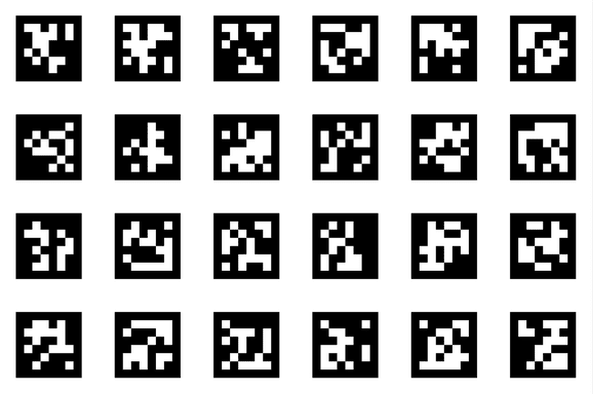
Notes:
AprilTags are a system of visual tags developed by researchers at the University of Michigan to provide low overhead, high accuracy localization for many different applications.

Slide 68
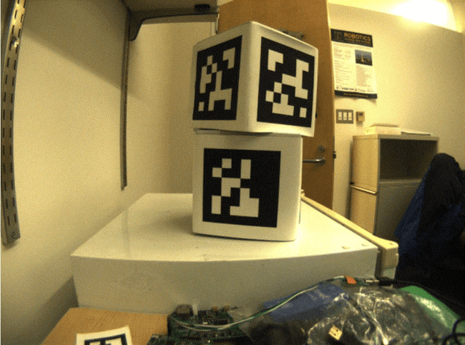
Notes:
An image from a camera is simply an array of values, corresponding to the color and brightness of each pixel.
First, we remove colors

Slide 69
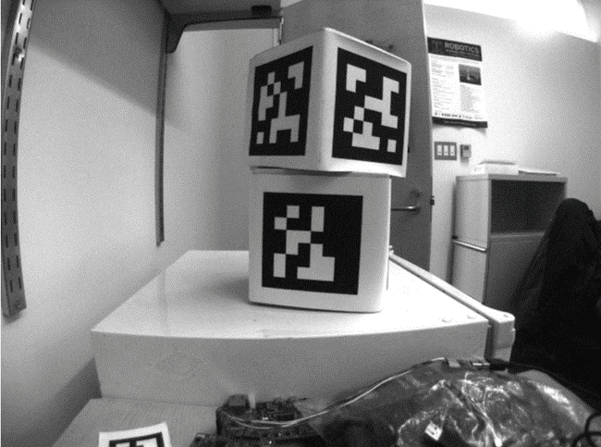
Notes:
We convert the image to a grey-scale (brightness-only) image. Color information is not needed to detect the black-and-white tags.
Next, we decimate.

Slide 70
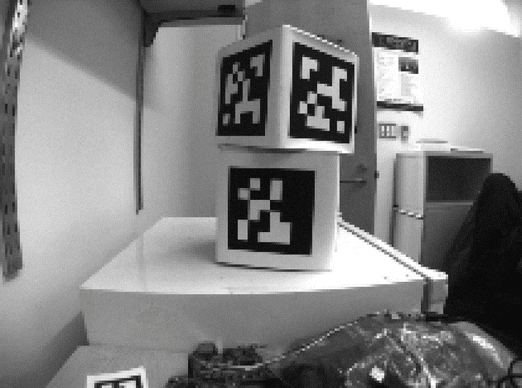
Notes:
Then we convert the image to a lower resolution. Working with fewer pixels helps the algorithm work faster. The full-resolution image will be used later to refine early estimates.
Next is enabling Adaptive Threshold.

Slide 71
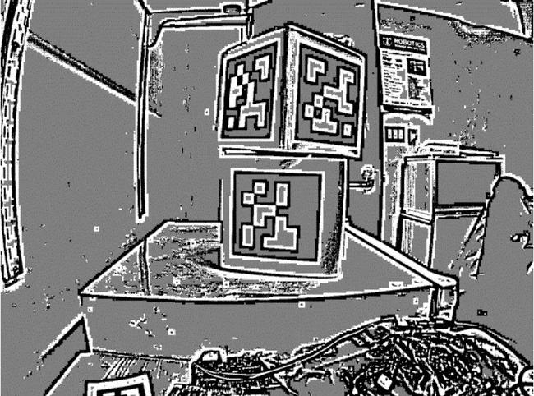
Notes:
An adaptive threshold algorithm is run to classify each pixel as “definitely light”, “definitely dark”, or “not sure”.
The threshold is calculated by looking at the pixel’s brightness, compared to a small neighborhood of pixels around it.
Next, we start Segmentation

Slide 72
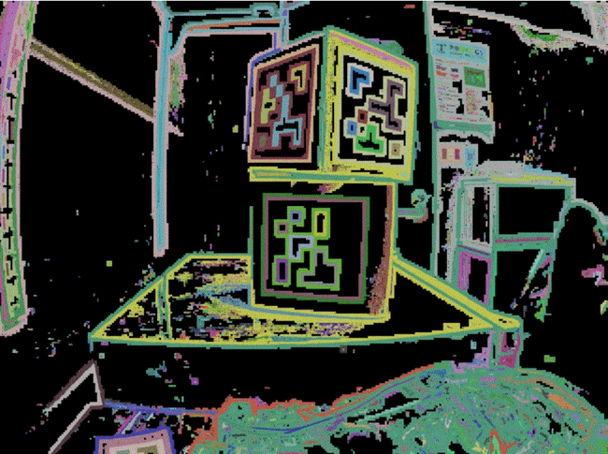
Notes:
Here, the known pixels are clumped together. Any clumps which are too small to reasonably be a meaningful part of a tag are discarded.
After this, we detect the quads

Slide 73
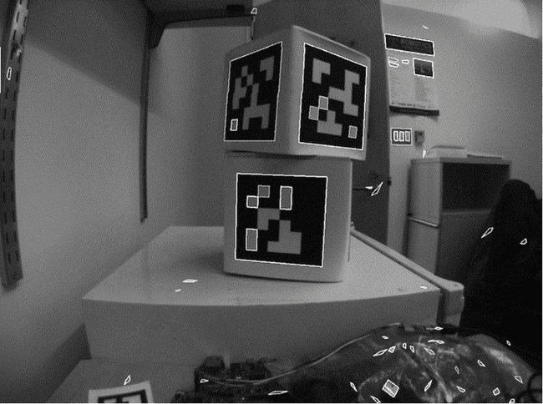
Notes:
An algorithm for fitting a quadrilateral to each clump is now run:
Identify likely “corner” candidates by pixels which are outliers in both dimensions.
Iterate through all possible combinations of corners, evaluating the fit each time
Pick the best-fit quadrilateral
Given the set of all quadrilaterals, Identify a subset of quadrilaterals which is likely a tag.
A single large exterior quadrilateral with many interior quadrilateral is likely a good candidate.
If all has gone well so far, we are left with a four-sided region of pixels that is likely a valid tag.
After this step, we decode the ID’s

Slide 74
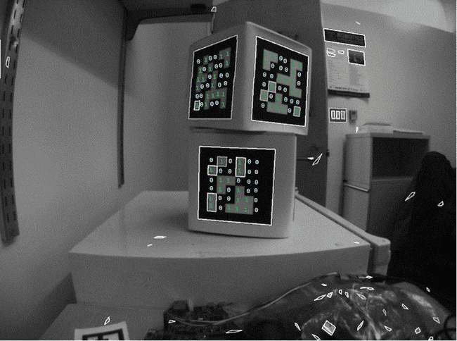
Notes:
Now that we have one or more regions of pixels which we believe to be a valid AprilTag, we need to identify which tag we are looking at. This is done by “decoding” the pattern of light and dark squares on the inside.
Calculate the expected interior pixel coordinates where the center of each bit should be
Mark each location as “1” or “0” by comparing the pixel intensity to a threshold
Find the tag ID which most closely matches what was seen in the image, allowing for one or two bit errors.
It is possible there is no valid tag ID which matches the suspect tag. In this case, the decoding process stops.
Last, we fit the quads

Slide 75
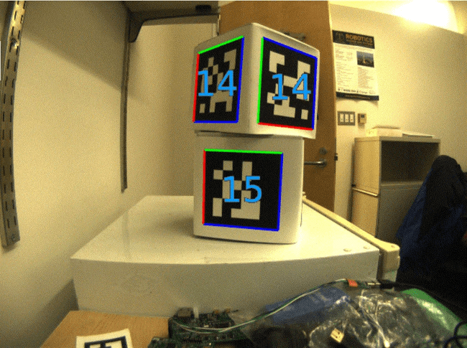
Notes:
Voila!

